Slide 1
Publish or Perish
Publish or perish: jak efektivně psát a publikovat vědecké články

Slide 2
ProQuest resources that support academic activities of research, teaching and publishing
Content:
Ebooks
Journals and other full text publications
Abstract and indexes databases
Tools: communication and publishing
COS
RefWorks
Dissertations

Slide 3
Company presentation
Notes:
Timeline?

Slide 4
Krzysztof Murawski
Krzysztof.murawski@emea.proquest.com
John Tsihlis, Sales Director John.Tsihlis@proquest.co.uk

Slide 5
ProQuest Mission
To create indispensable research solutions that connect people and information
Notes:
As a company, ProQuest stands for the power of discovery through research, and its employees work to deliver on that promise every day.
We aim to provide tools that reflect your passion for high quality information, that are easy to access and which draw on expert specialist editorial expertise with tailored applications.

Slide 6
Innovation
1939
Dissertations on Microfilm and Print
1992
English Poetry on CD-ROM launched
1996
Literature Online launched with more than 350,000 full text works in poetry, prose and dram
Technology
1938
University Microfilms founded
1951
ARL recognizes UMI as Publisher of Record for all US dissertations
1998
Library of Congress recognizes UMI as offsite repository of Digital Dissertation Library
Recognition
Notes:
UMI Dissertations serves Authors and the Scholarly Community:
The recognition and reputation the company has continued to build:
Beginning in 1938 filming dissertations, by 1951 (13 years later) the American Research Libraries recognizes UMI as the Publisher of Record for US dissertations.
In 1998, the Library of Congress recognized UMI as the Repository its Digital Dissertation Library.
Recognition grows with as technology grows:
In the 1930s, Eugene Power builds the first commercial microfilm camera.
In 1987, UMI is the first company to publisher an Index and Abstract product on CD-ROM.
1997, UMI began to digitize its dissertation holdings, prospectively, as well as retrospectively.

Slide 7
Research cycle

Slide 8
Research and teaching
Activities | Research | Teaching | Content
Problem definition | Discovery |  | Search for right terms, ideas, outlines
Narrowing | x |  | With the use of early research – narrowing of concepts, first subject literature gathered
Collaborators, funding | Organisation |  | Finding out other relevant projects, collaborators
Project definition | x | Inclusion into teaching, colalbroation | Different aspects: collaboration, literature search, timing, funding
Research
Lecture / seminar |  | x | Planning, preparation, actual running of a seminar program in relation to research project
Publication | x | x | Planning, preparing, writing, sharing

Slide 9
Research process
Selection of topic
Exploration and initial research
Review through graduate seminars
Writing
Presentation to peers
Publication
Editing
TEACH
I
N
G
Peer Feedback and Comment
Notes:
Example illustrated here is of a major research project such as a monograph (variations can apply – see next slide)
Teaching runs in parallel but as seniority increases teaching responsibilities go down

Slide 10
Dissertations
All stages of the research and teaching cycle

Slide 11
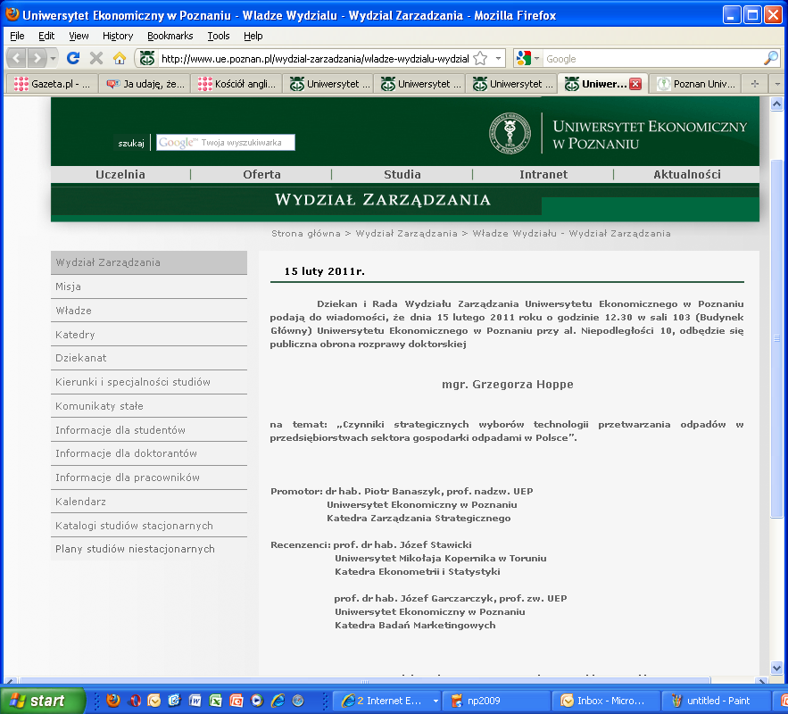
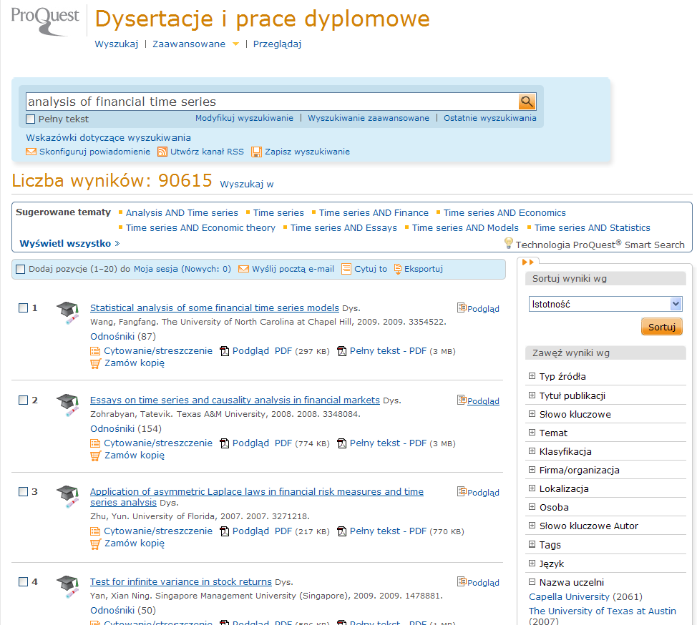
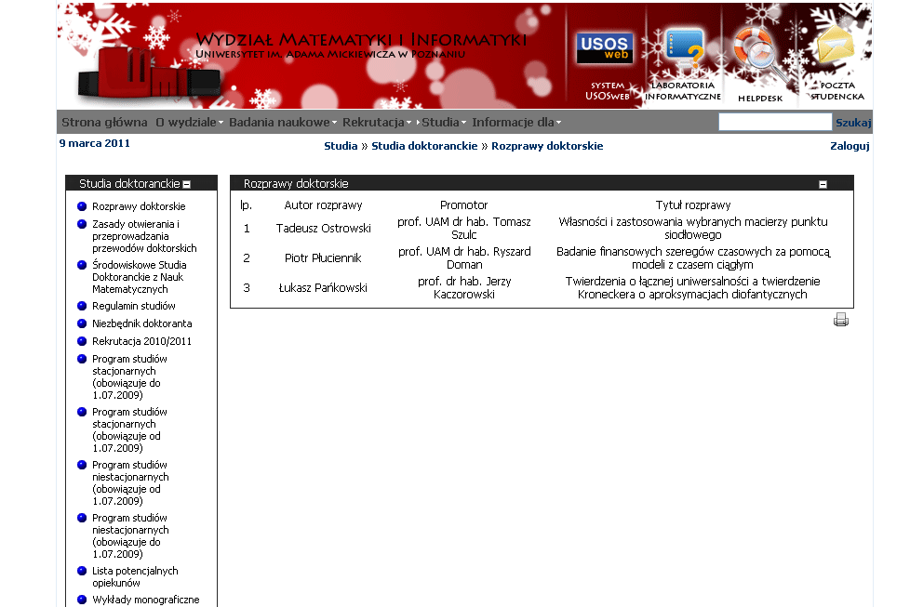
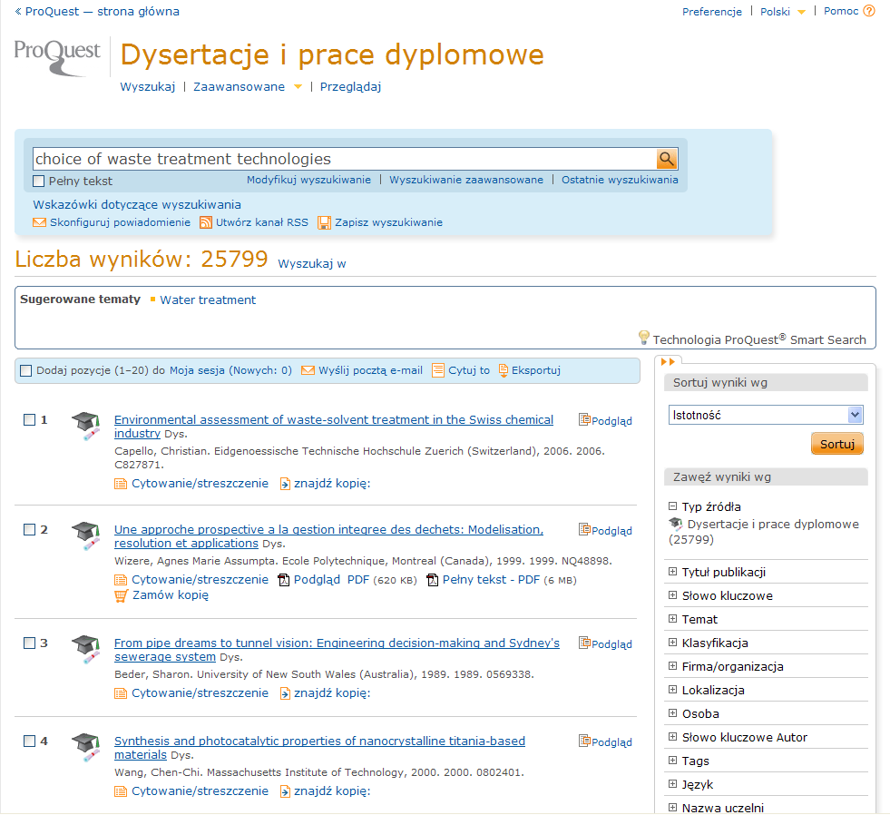
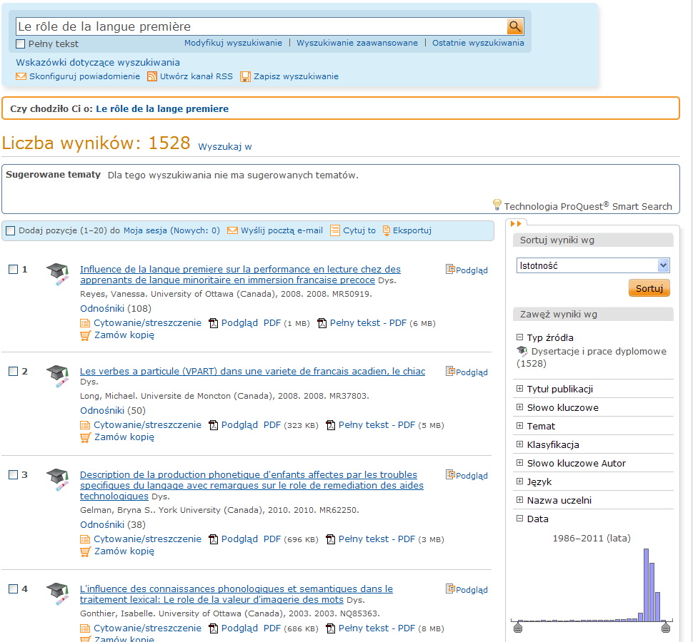
ProQuest Dissertations and Theses
analysis of financial time series

Slide 12
ProQuest Dissertations and Theses - summary
Abstract version
2,9 mln Dissertations from the last 250 years, indexed and abstracted, over half with preview of 24 pages and individual purhcase option.
Full Text version
1,4 mln dissertations
From 2008 full text sercheable.
All disciplines
Possibility of free publications of own dissertations
Harvard, Yale, Princeton publish here for over 50 years

Slide 13
Recognition, publication and citing
Publishing in QDT – withISBN provision – is a fully recognised form of scientific publishing, that can be then quoted and listed in publications lists.
ProQuest do not charge a fee for participating in publishing program if dissertations are submitted via the electronic submission system.

Slide 14
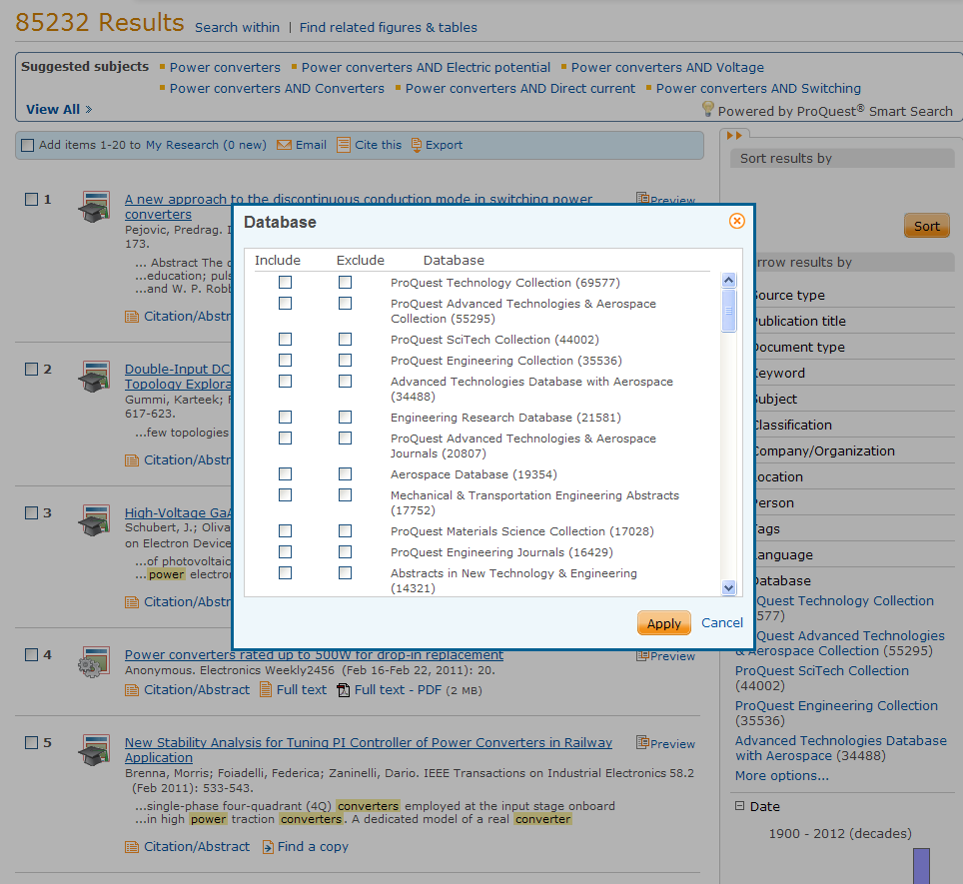
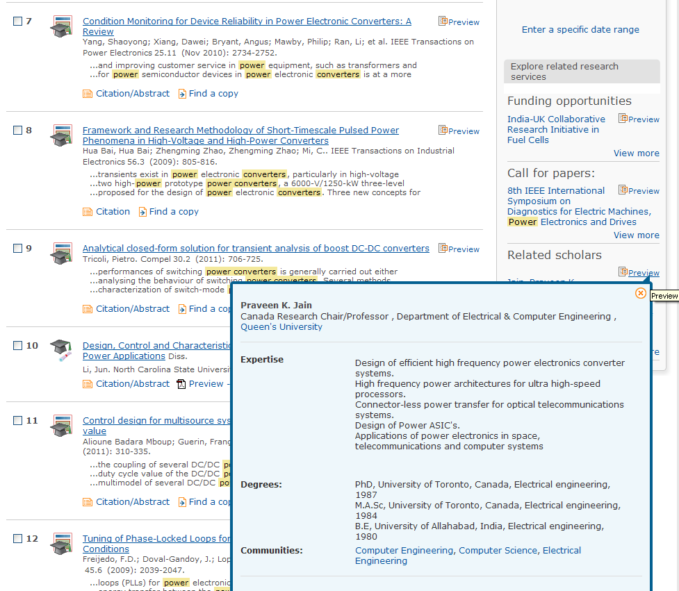
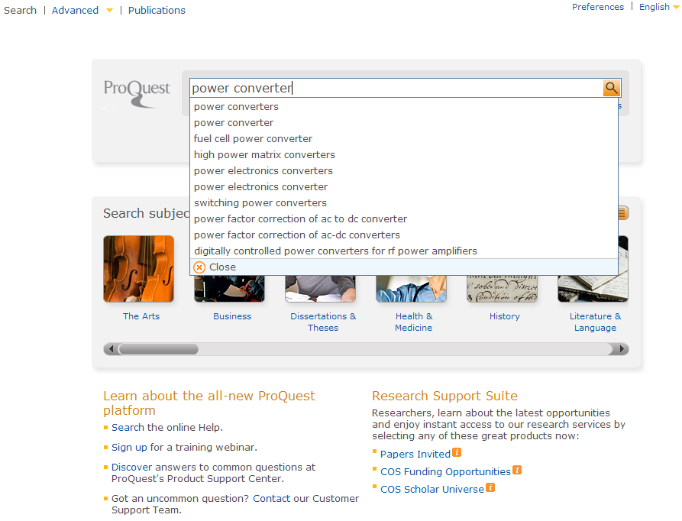

Slide 15
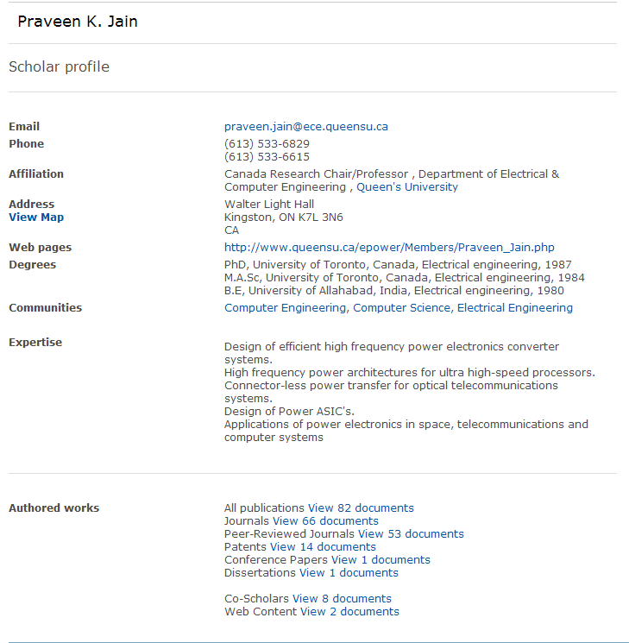
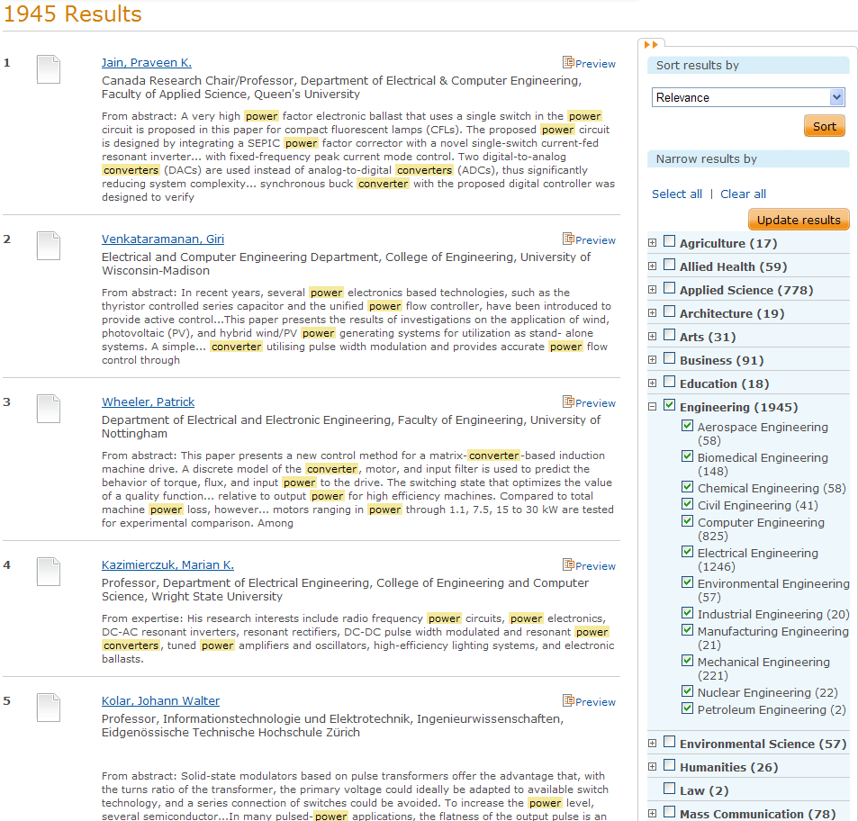
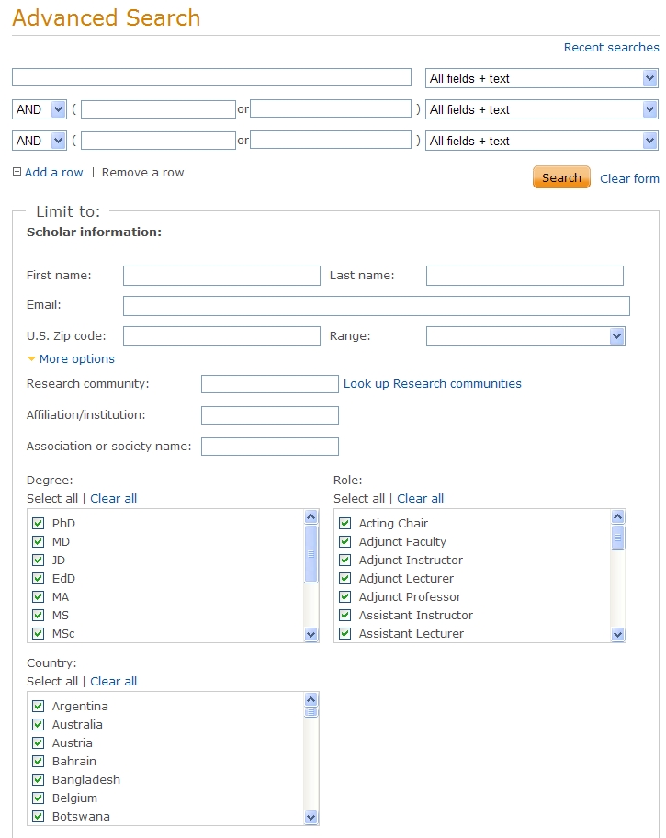
Find out about ongoing research
Community of Scolars

Slide 16
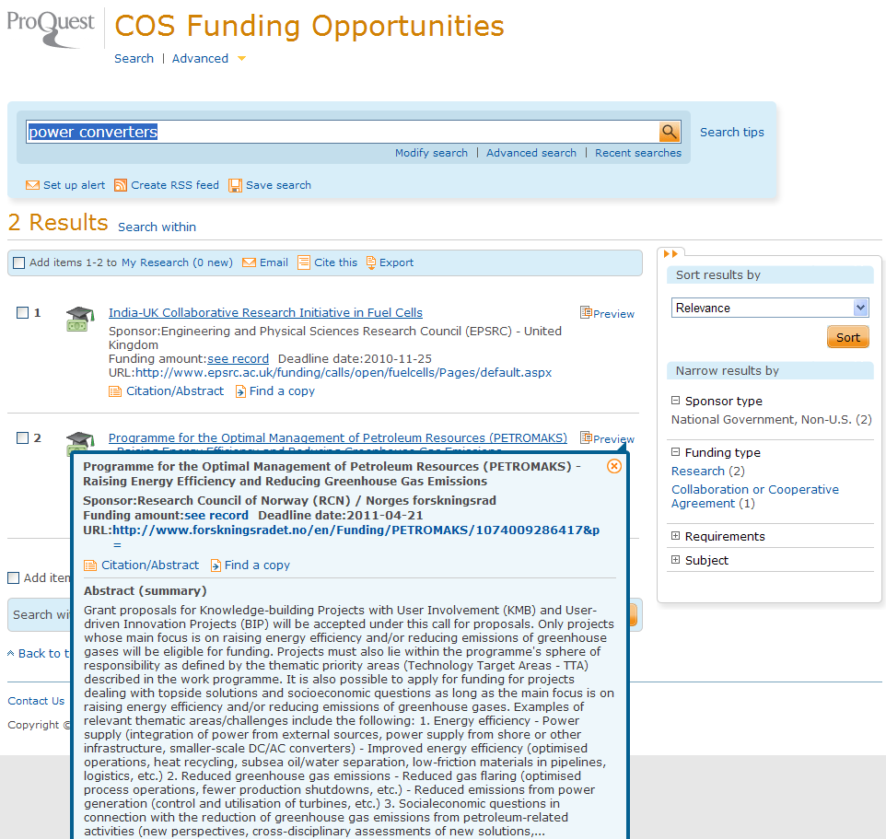
Planning own research
Cooperation, financing and publishing options

Slide 17
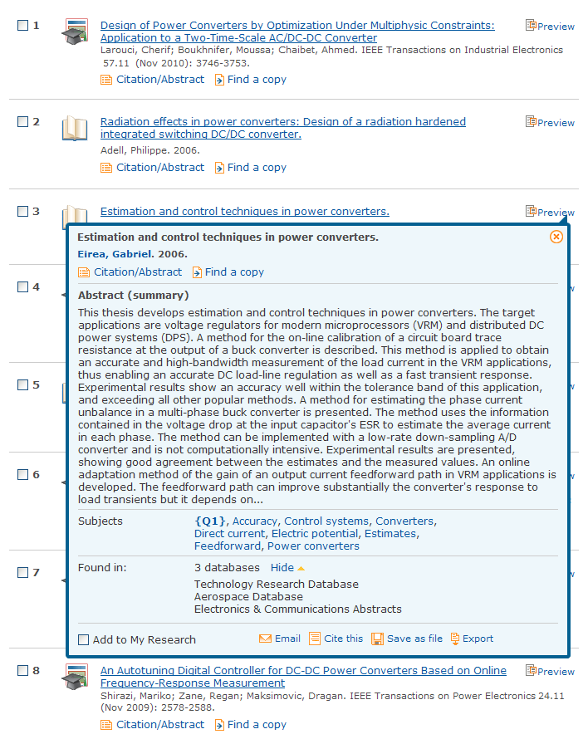
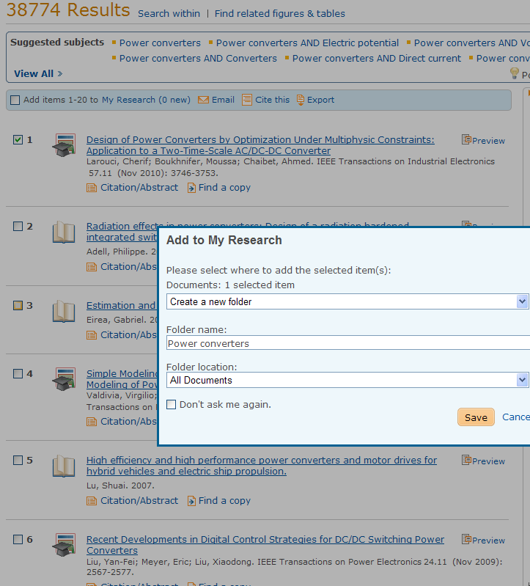
Quoting and publishing
Refworks and MyResearch on Proquest platform
Finding out subject literature
Saving references for future use
Preparing text for publication

Slide 18
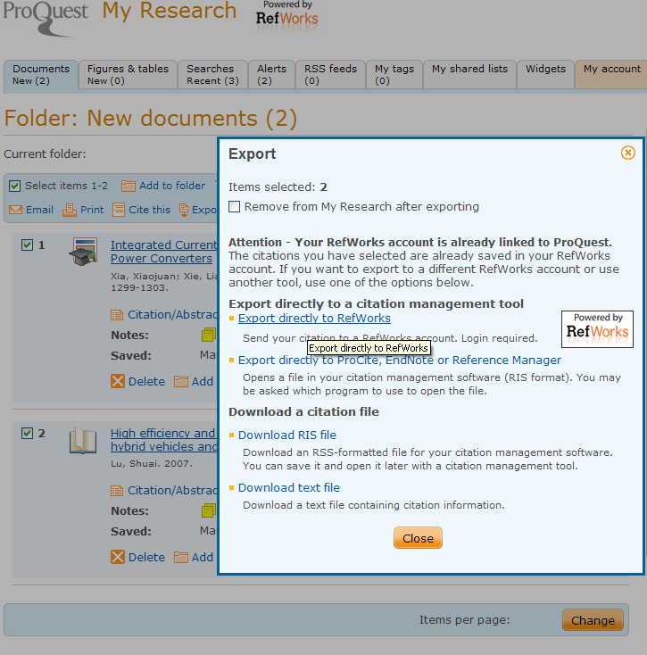
Exporting to RefWorks
RefWorks – citations management tool

Slide 19
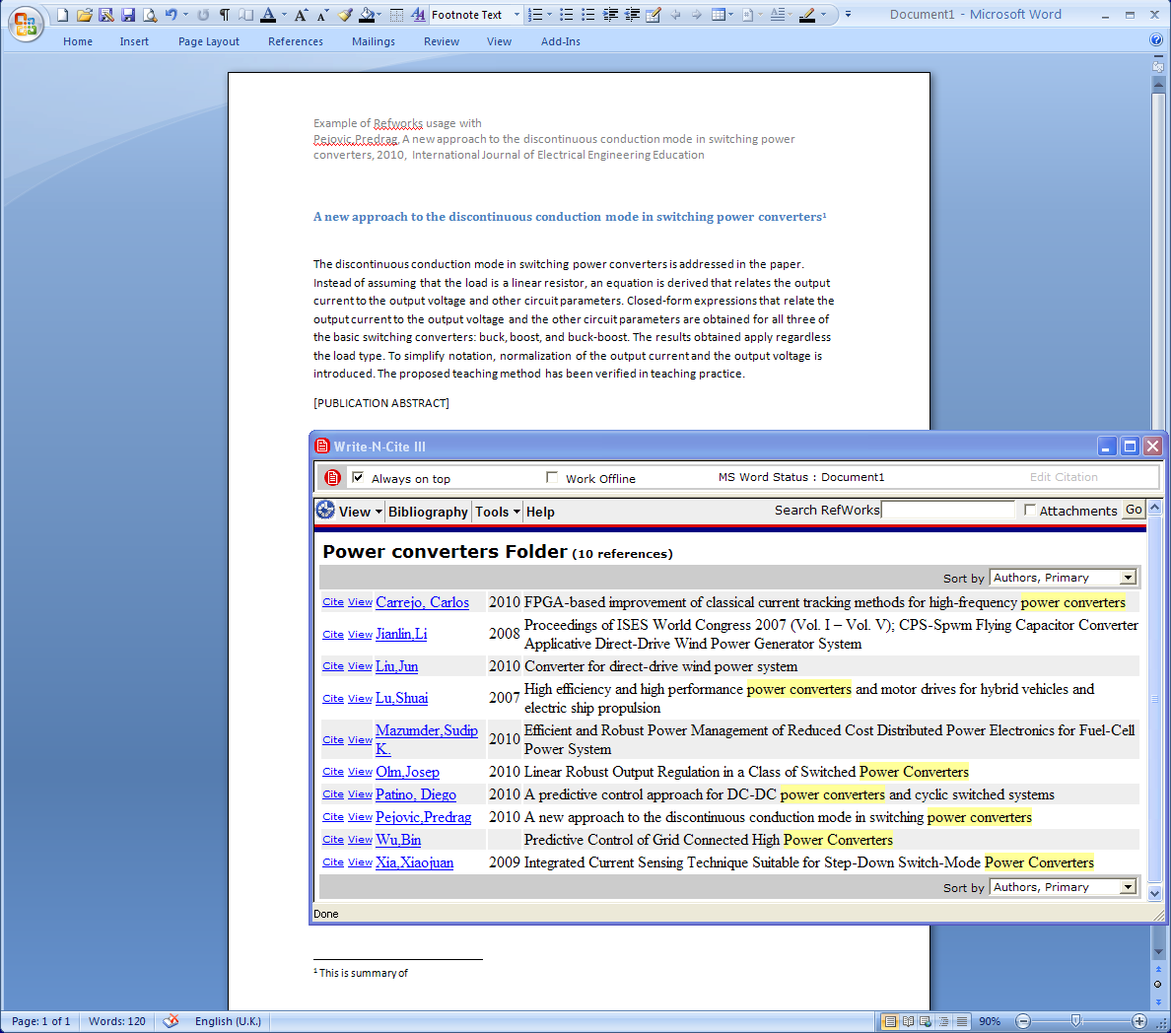
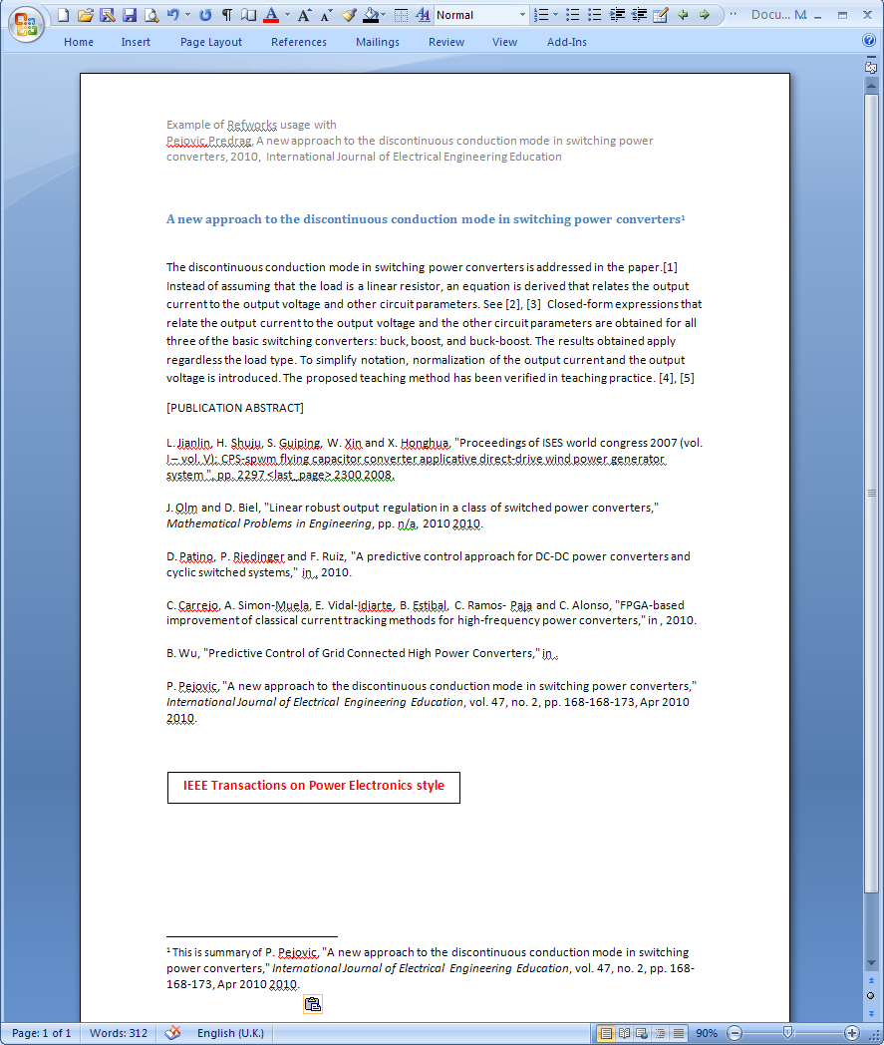
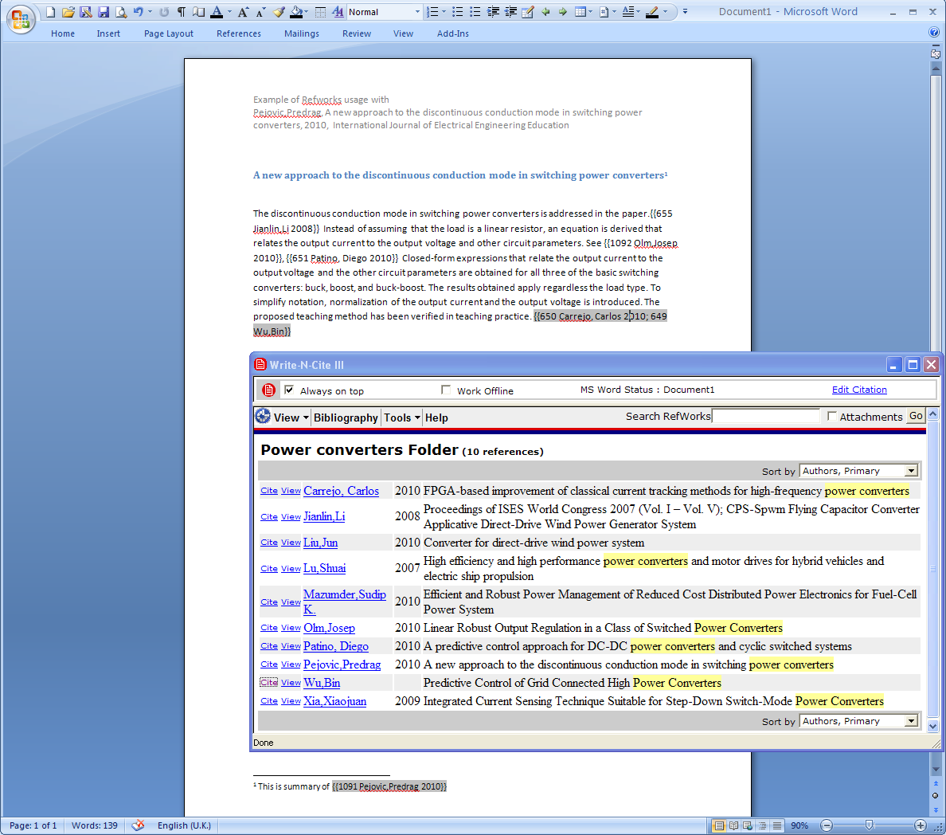
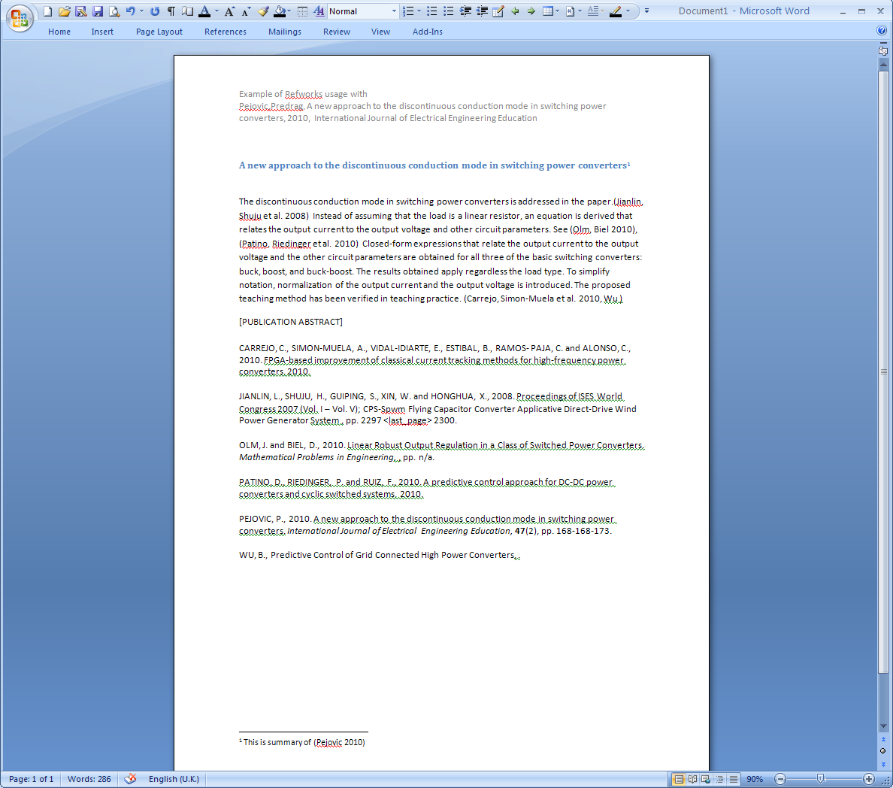
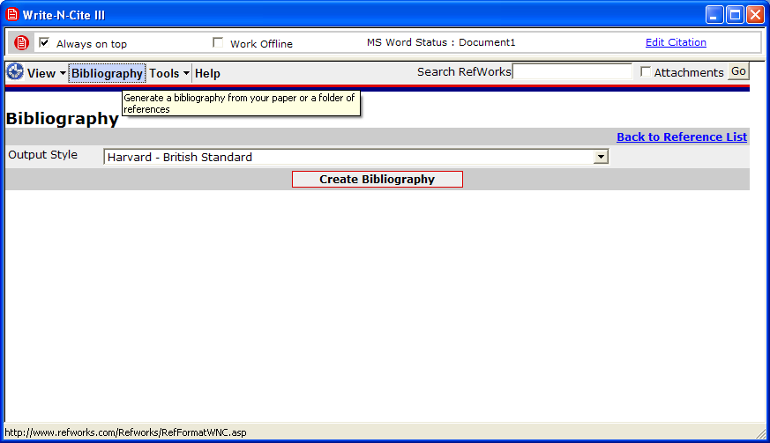
Citation in an article on A new approach to the discontinuous conduction mode in switching power converters

Slide 20
Teaching... Syllabus...
Lecture in Management
Introduction. Decision making, managerial functions.
Organizational Culture and social environments. Stakeholders, limitations
Social responsibility vs business responsibility of managers
Planning in organizations
Managing the organization
Tools and techniques of planning.
Changing structure of organizations
Leadership
Managerial control.

Slide 21
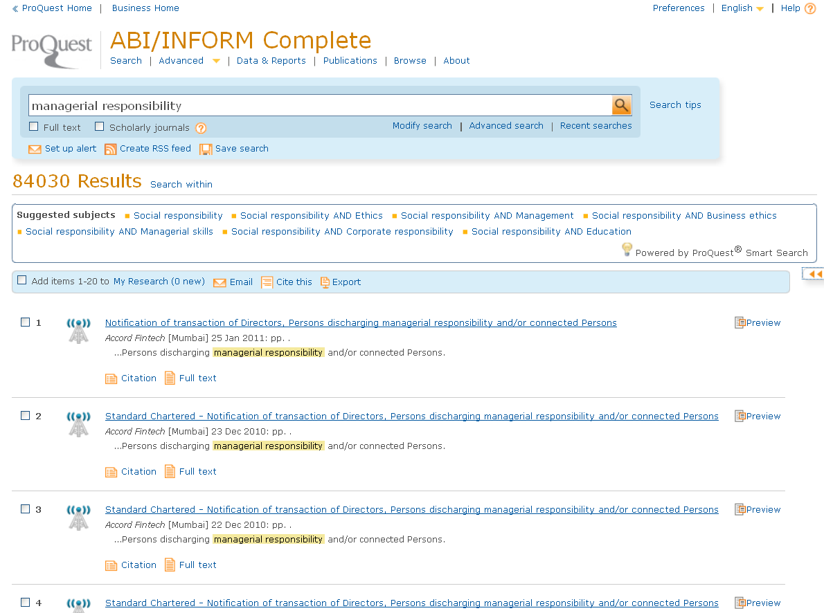
Managerial responsibility

Slide 22
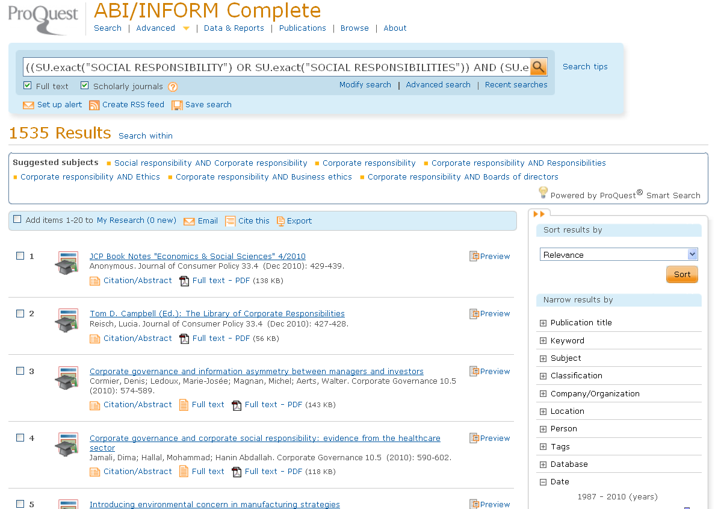
Social responsibility AND Corporate responsibility

Slide 23
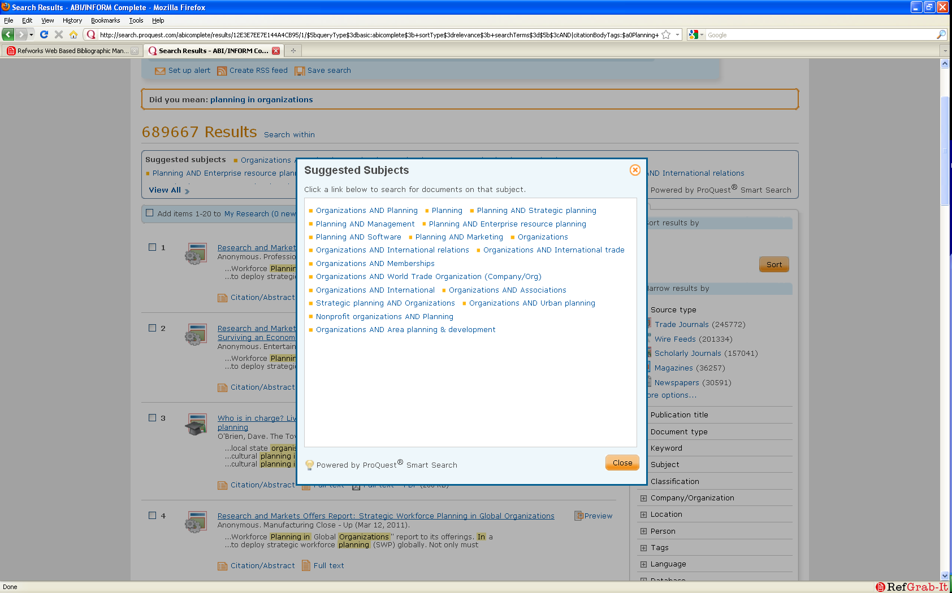
Planning in organisations

Slide 24
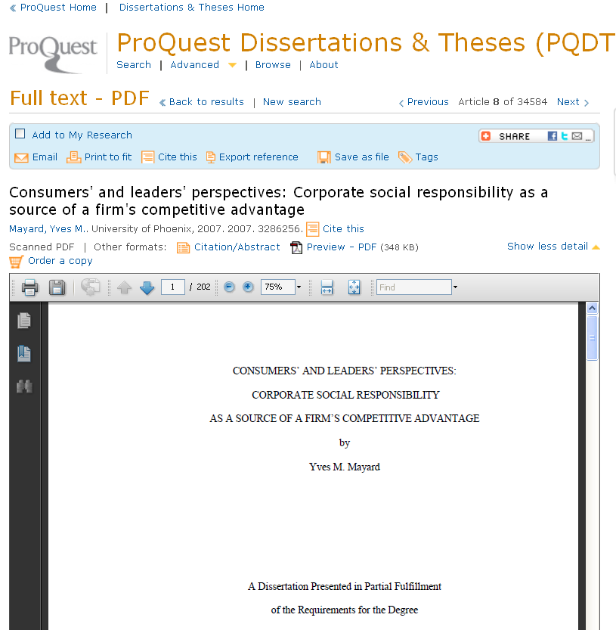
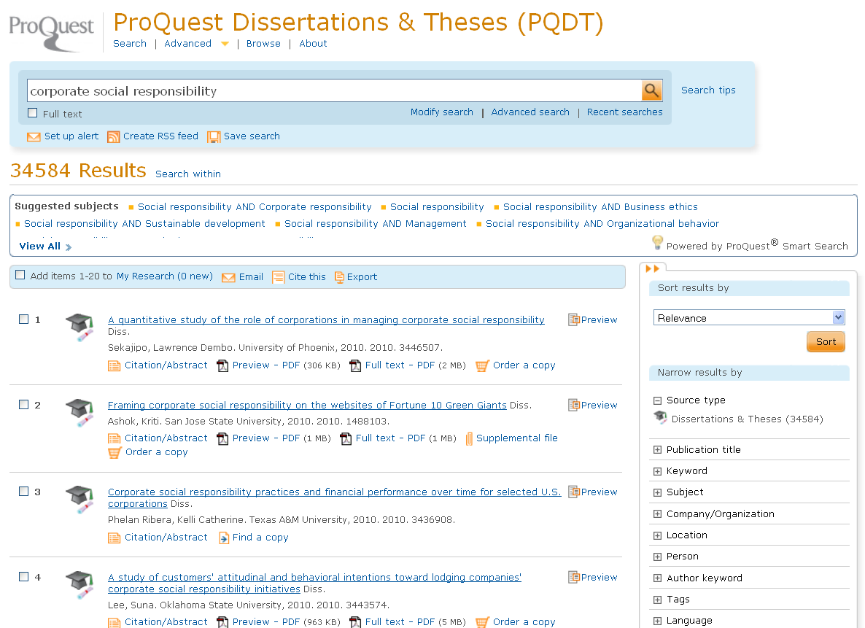
Research, promote, supervise

Slide 25
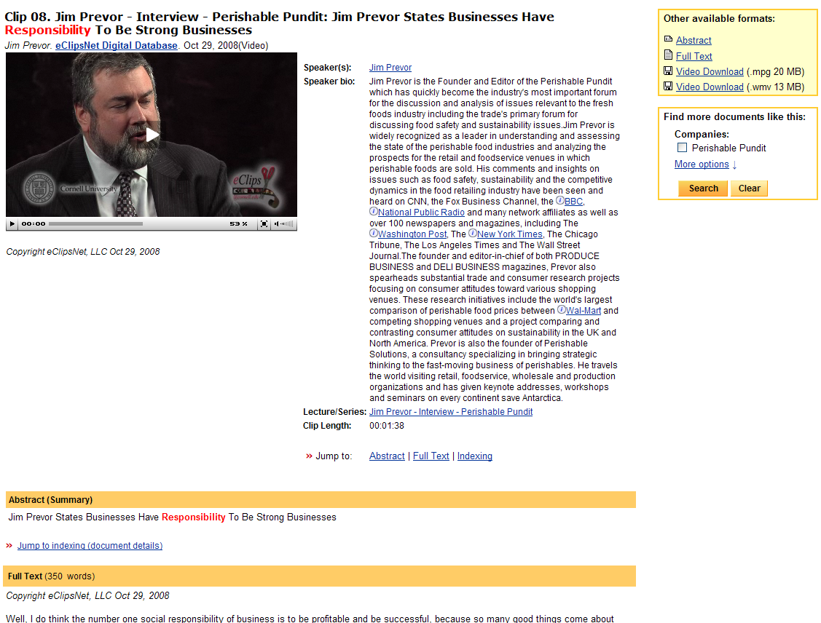
Teach
Videos for management courses

Slide 26
Variety of resources
That give subject coverage from different angles
Digital National Security Archives
Documents On British Policy Overseas
Historical Newspapers
Periodical Archives Online

Slide 27
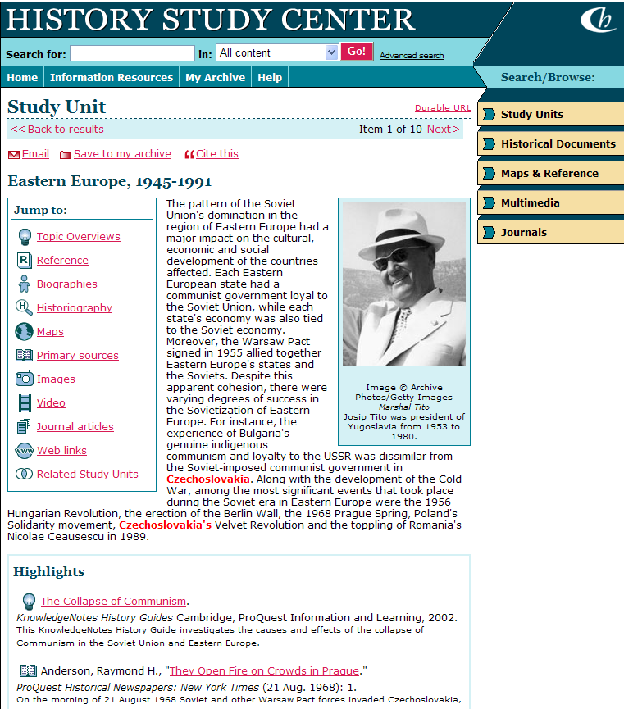
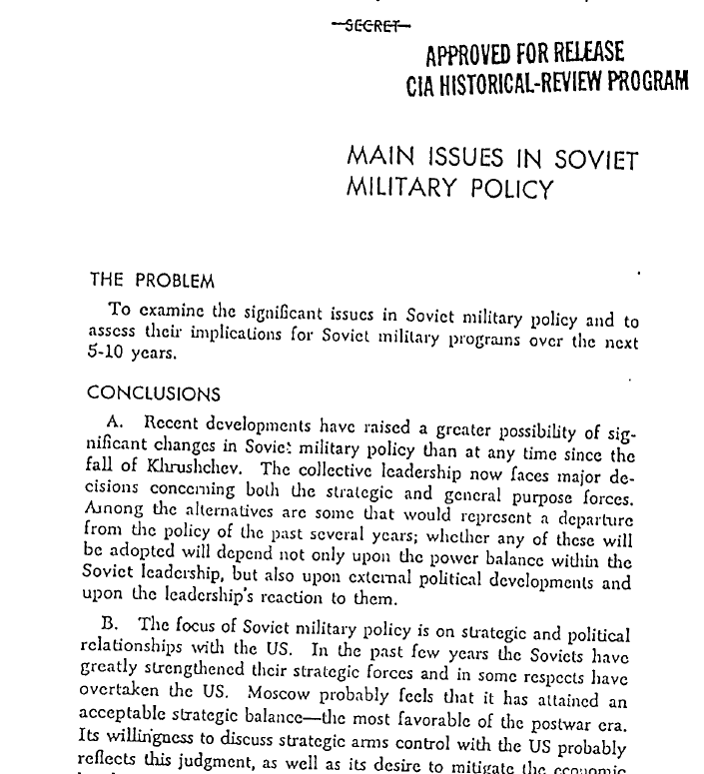
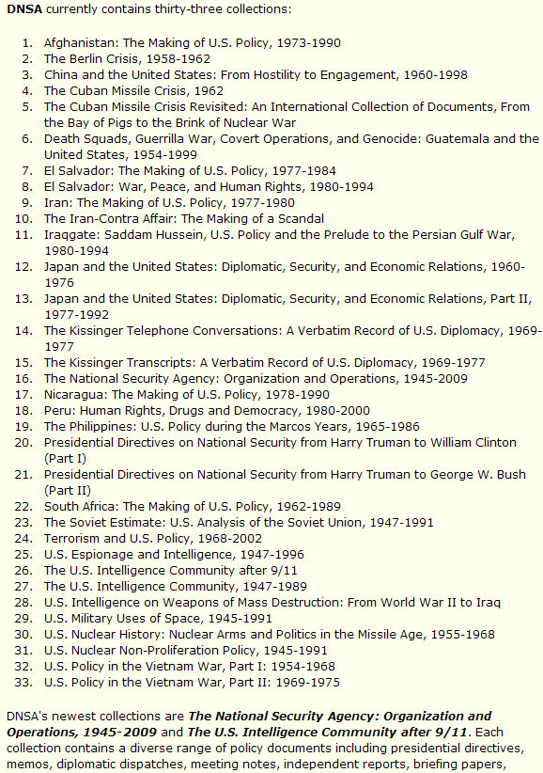

Slide 28
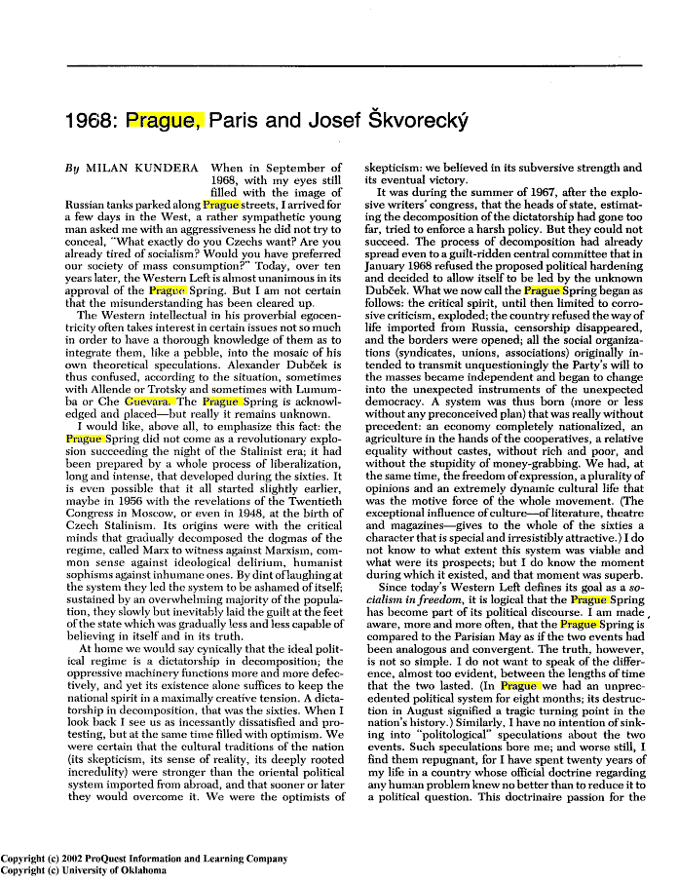
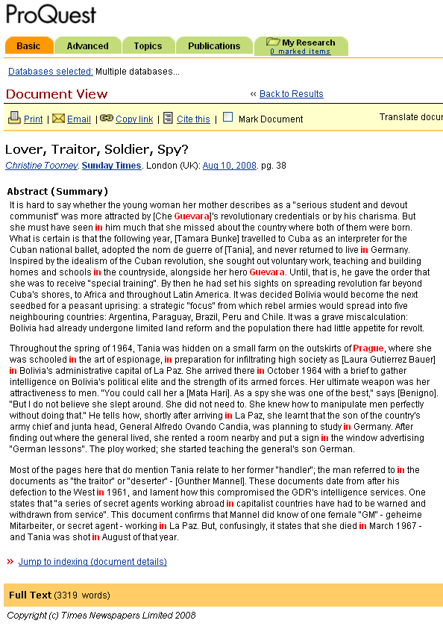
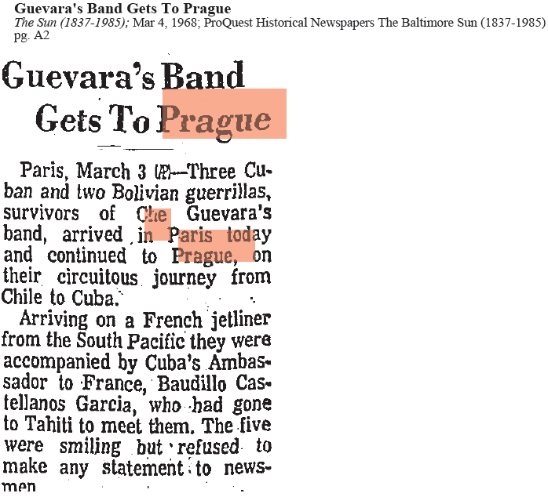
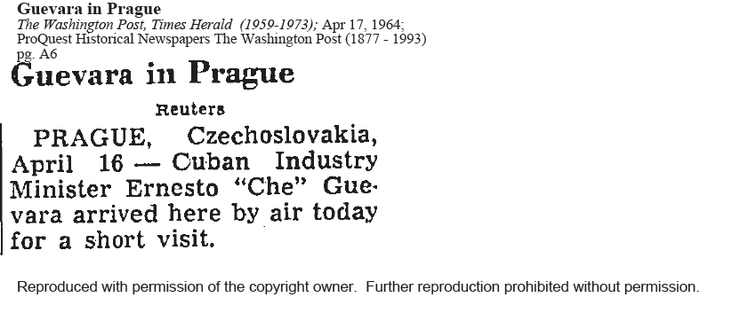
International communism...
DNSA
Press

Slide 29
Collect literature... Publish... Collaborate
RefWorks

Slide 30
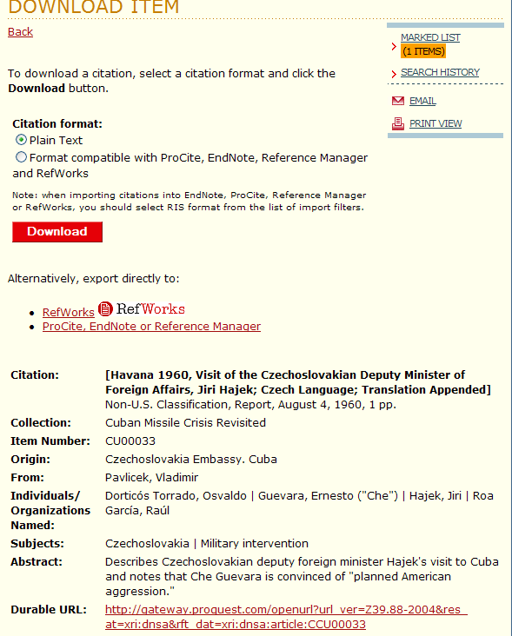
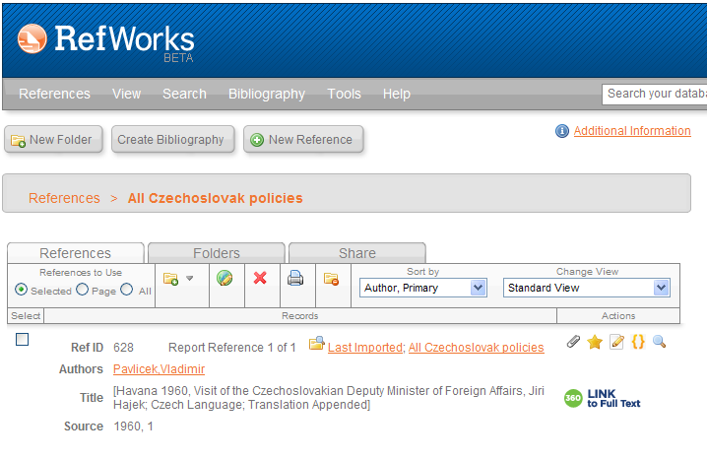
Citing and using
PDF attached

Slide 31
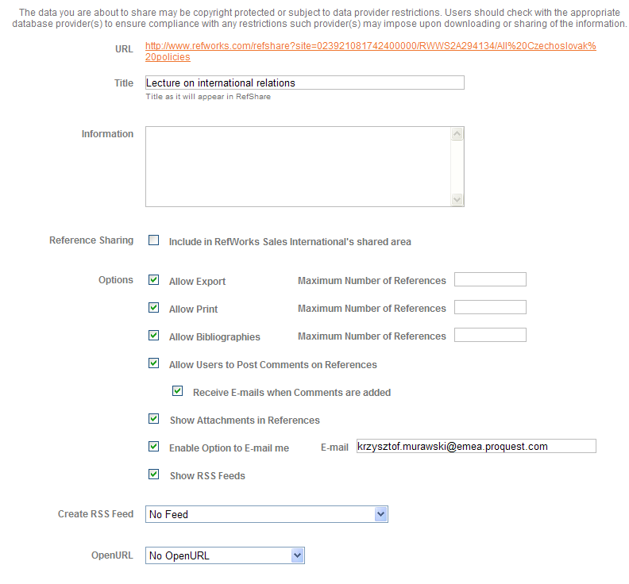
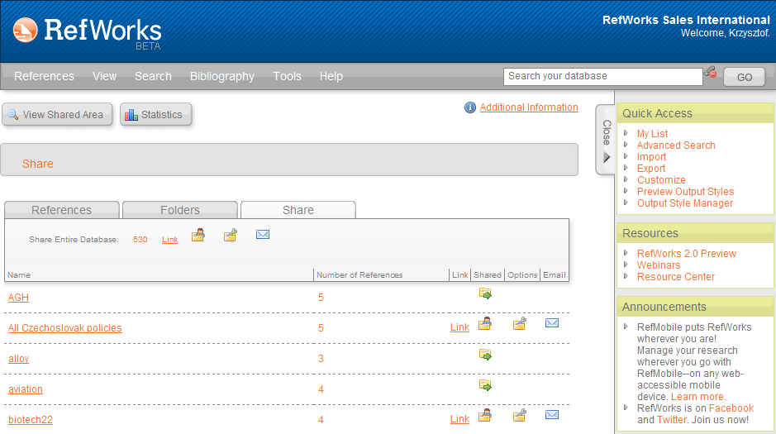
Sharing folder with students
link> to folder: http://www.refworks.com/refshare?site=023921081742400000/RWWS2A294134/All%20Czechoslovak%20policies

Slide 32
Arts

Slide 33
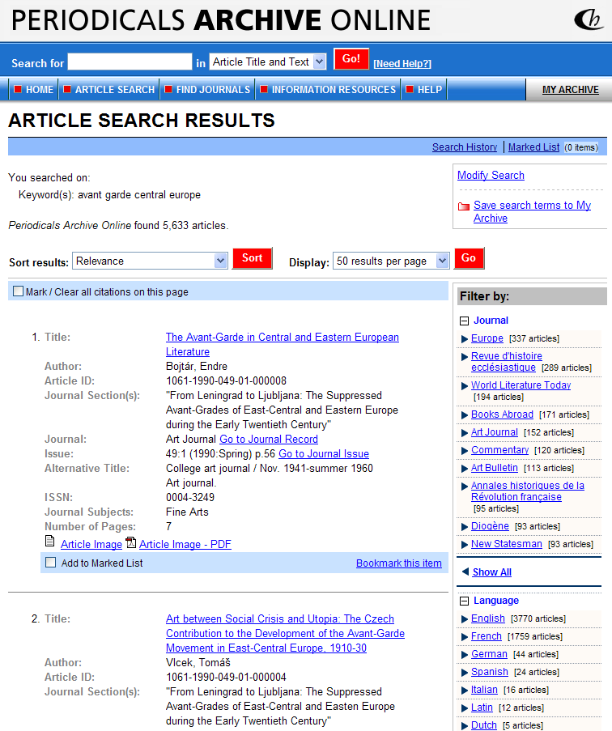
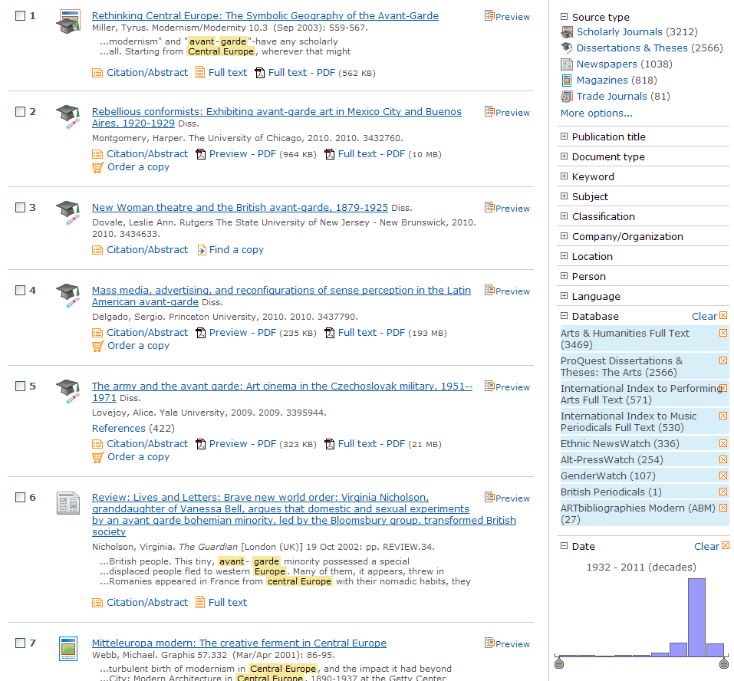
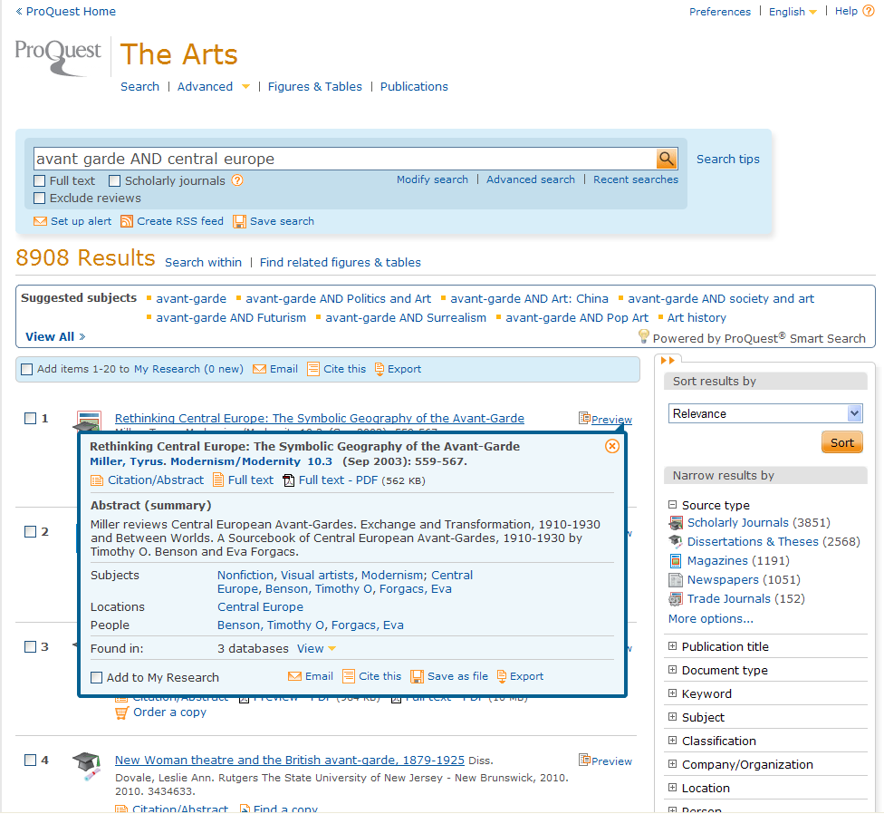
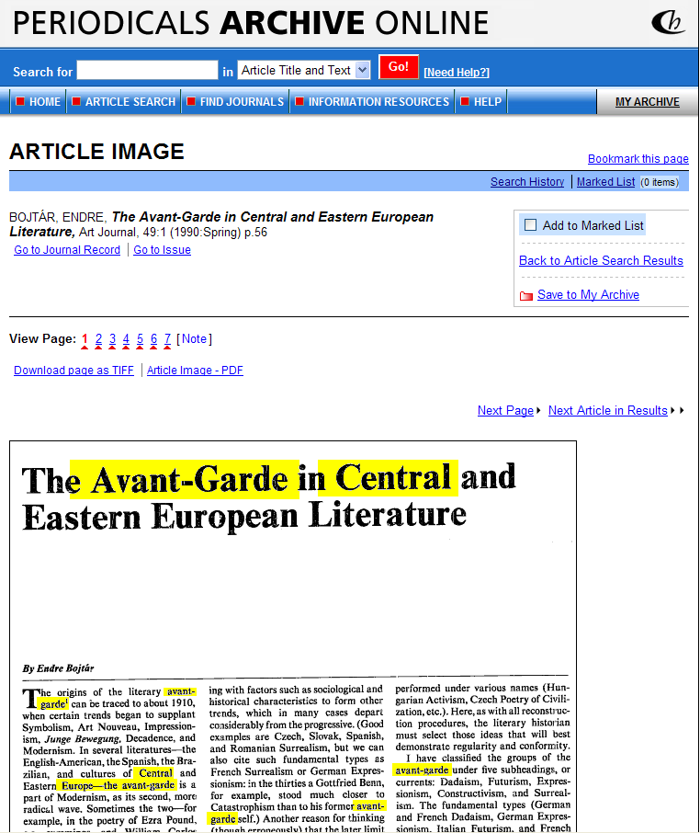
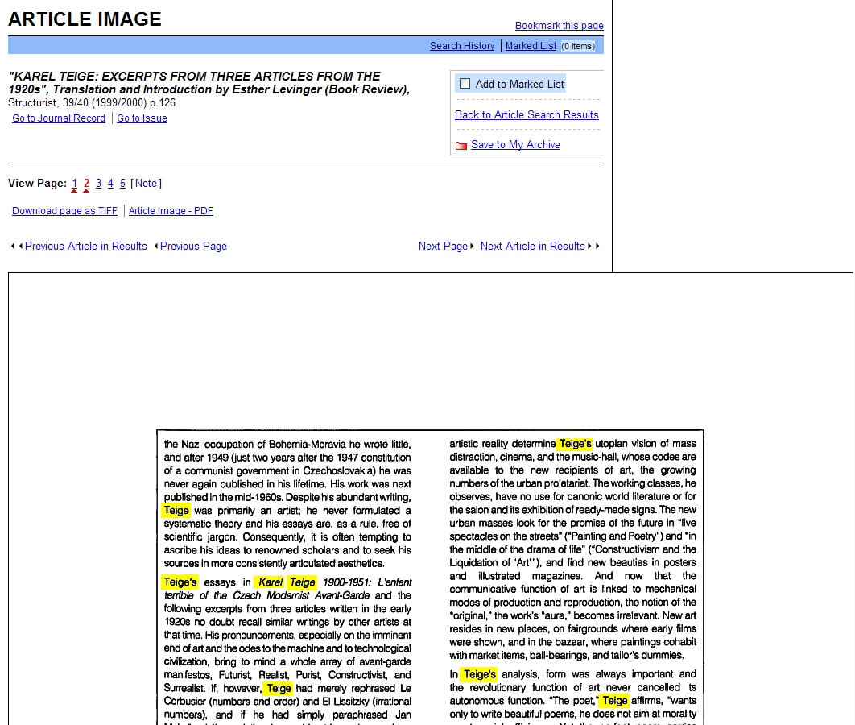
Awangarda w Europie Środkowej

Slide 34
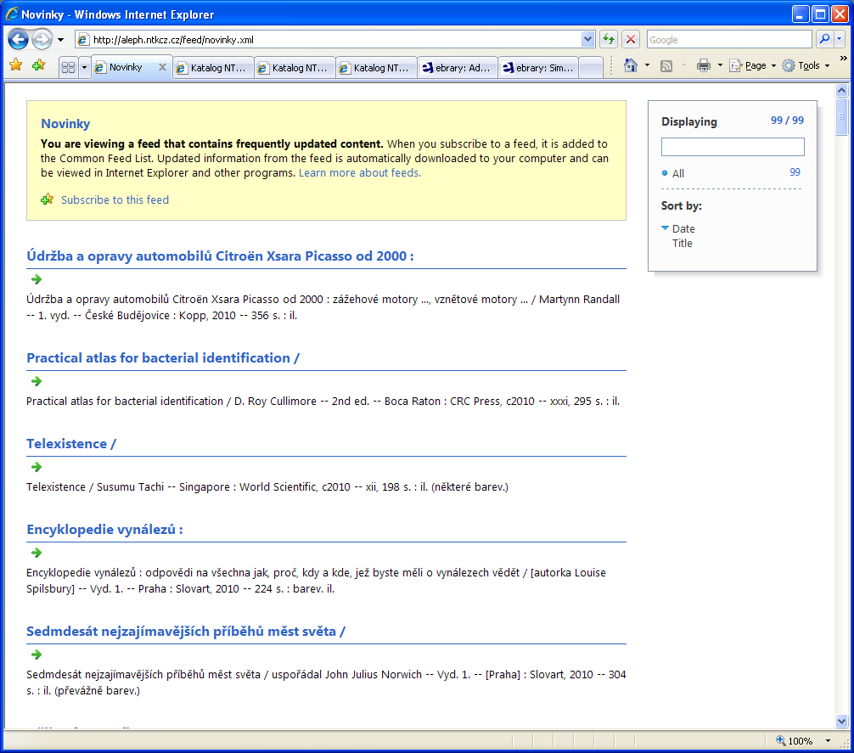
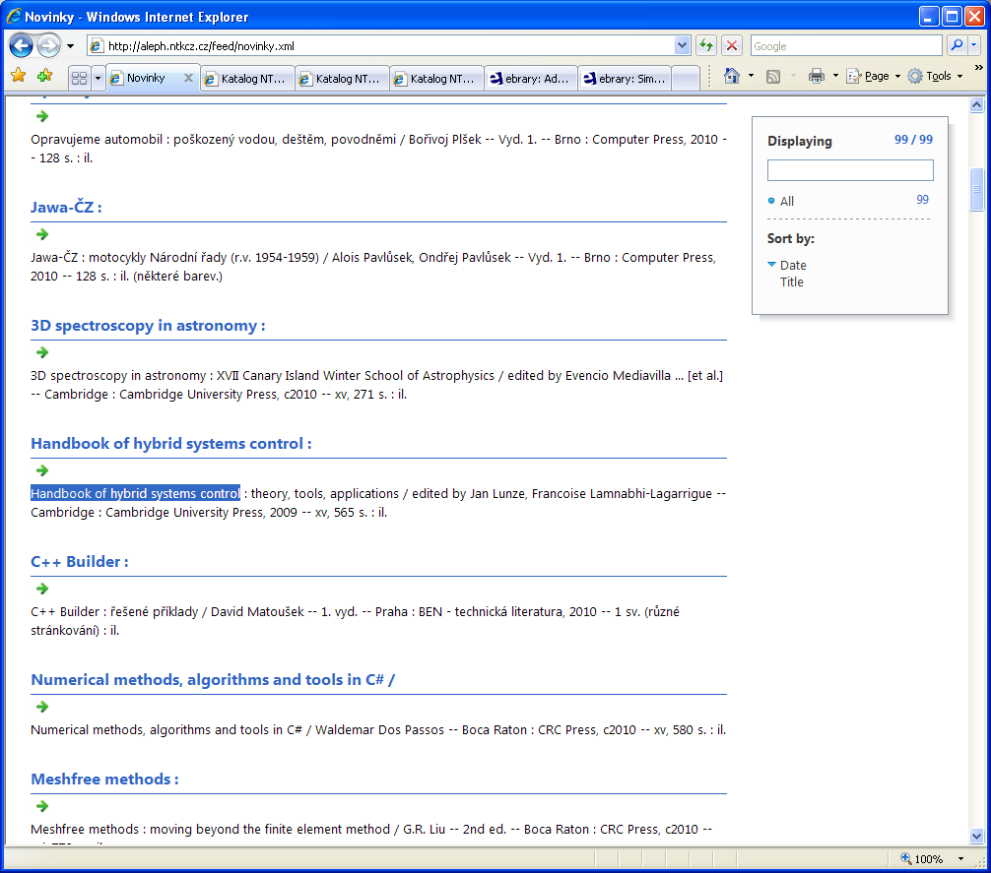
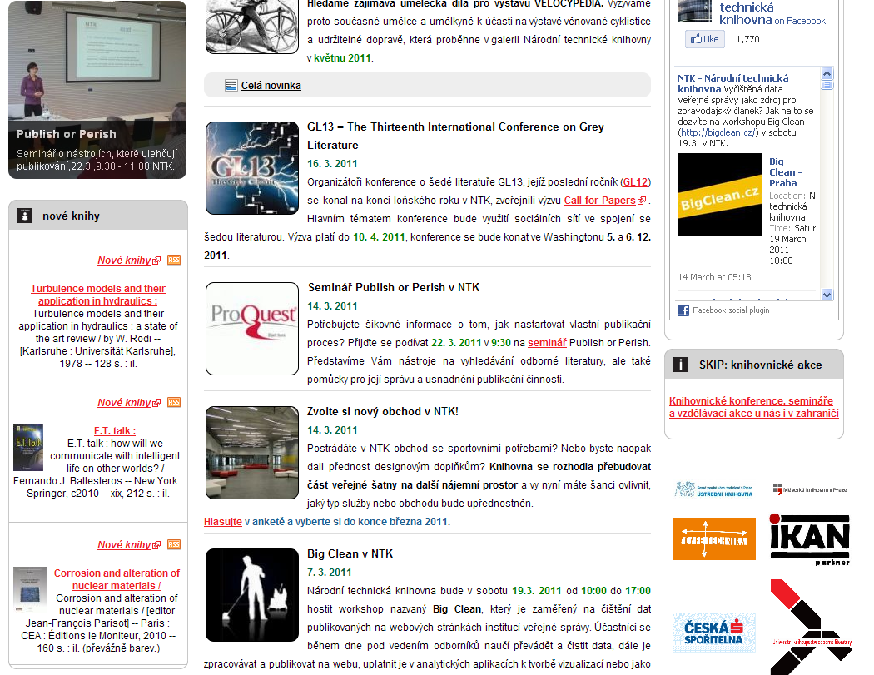

Slide 35
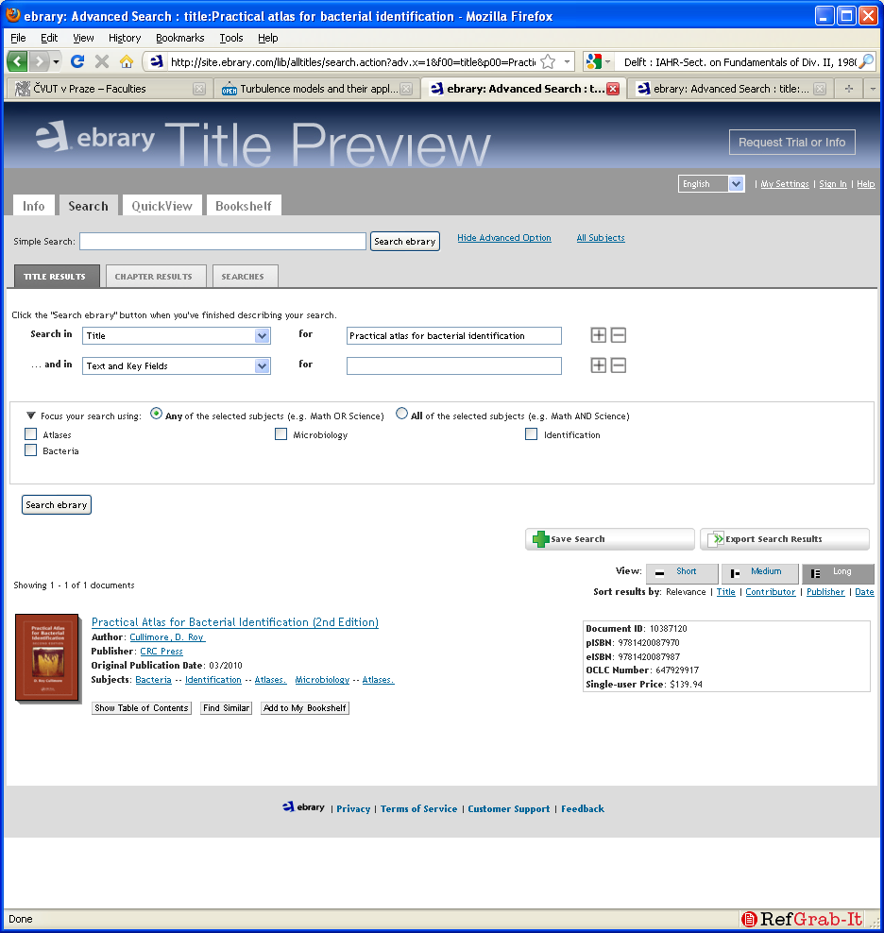
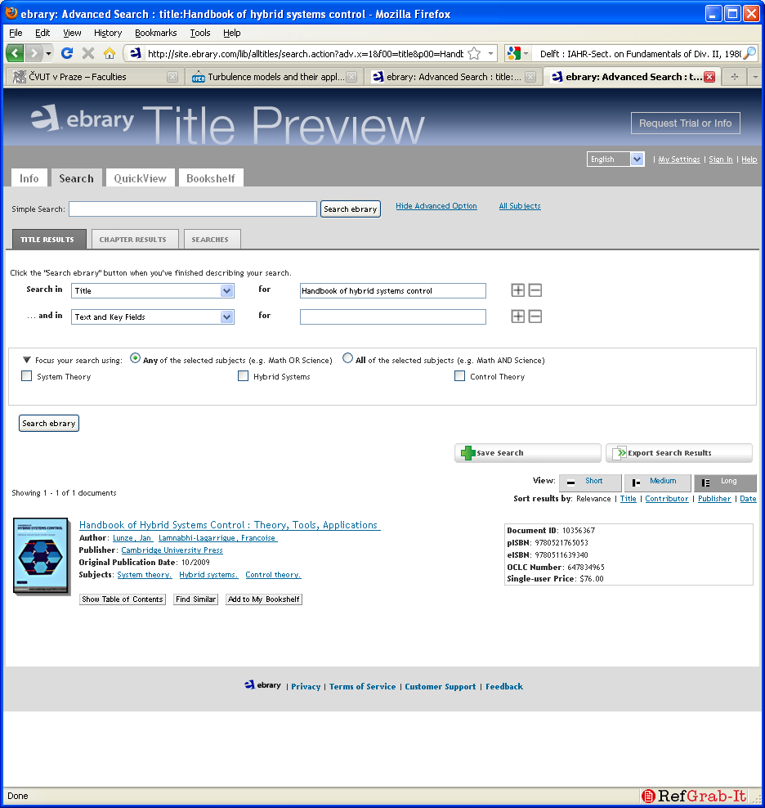

Slide 36
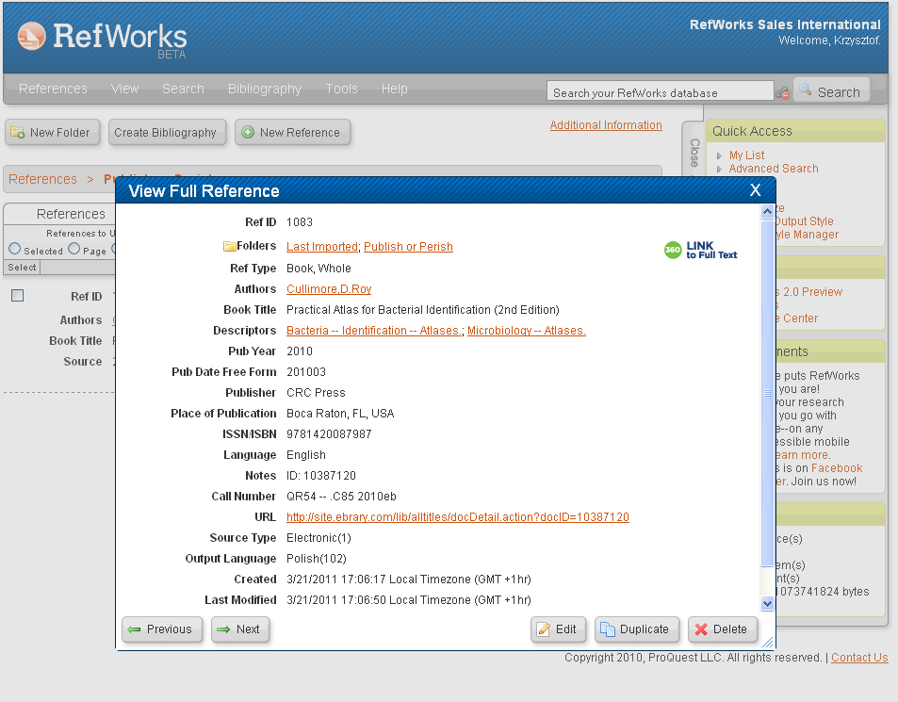
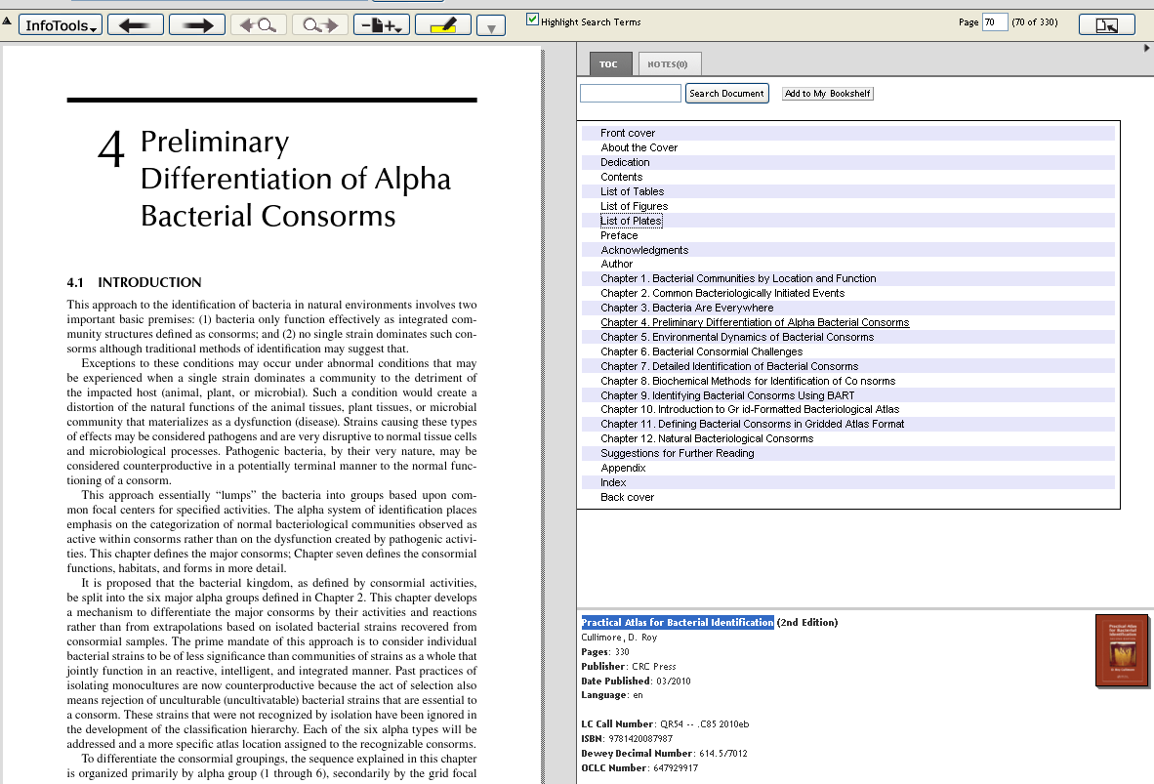
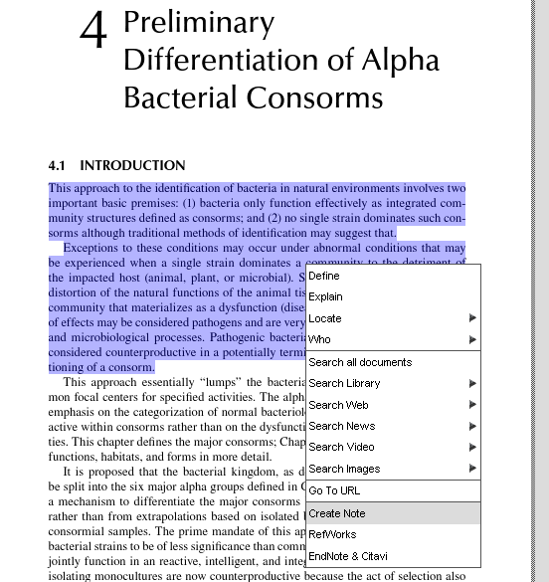

Slide 37
Company Overview
Founded in 1999
Headquartered in Palo Alto, CA, USA
More than 3,000 library customers
worldwide, serving over 19.2M end-users
More than 273,000 titles from 500 publishing partners
Flexible e-book models
Subscription (pioneered by ebrary)
Purchase (perpetual access)
Patron Driven Acquisition (PDA)
Short Term Loans (Q1 2011)
E-approvals with YBP
Software as a Service (SaaS) licenses available
Target markets: academic, corporate, public, and government
30% revenue growth in 2010
33% increase in usage in 2010

Slide 38
Sample Publishing Partners

Slide 39
ebrary Interface
http://site.ebrary.com/lib/demo/home.action

Slide 40
Questions?
Thank you very much for your attention
Live examples?
Krzysztof Murawski
Krzysztof.murawski@emea.proquest.com
John Tsihlis, Sales Director John.Tsihlis@proquest.co.uk

